Slide 1
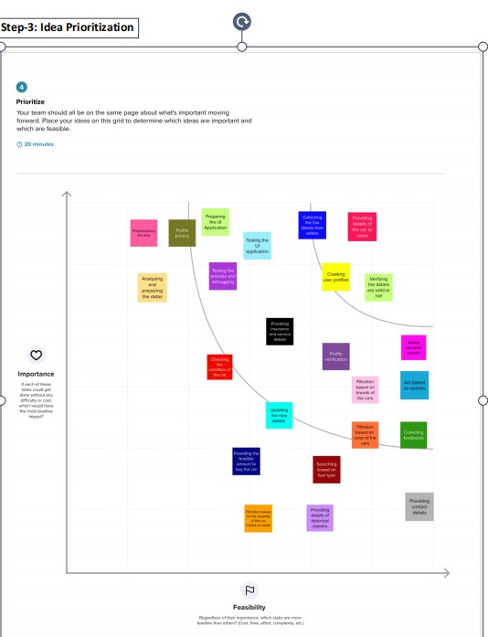

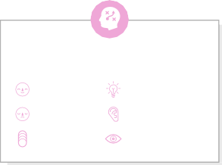


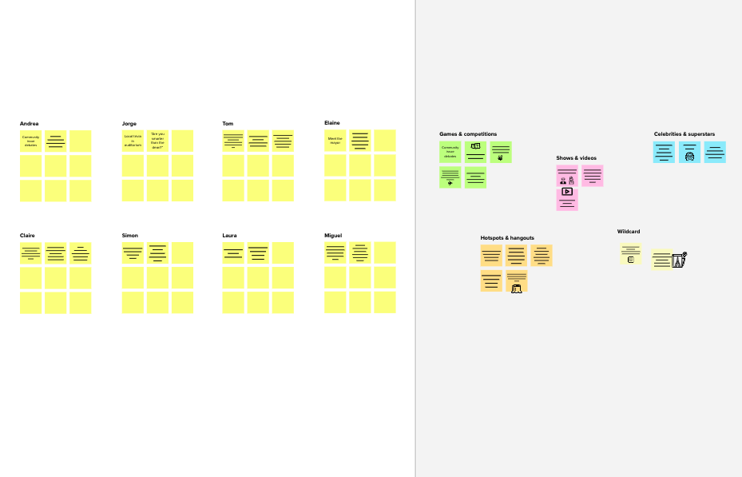




IDEATION PHASE
Brainstorm & Idea Prioritization Template
Date | 10 September 2022
Team ID | PNT2022TMID10480
Project Name | Car Resale Value Prediction
Maximum Marks | 4 Marks
Brainstorm & Idea Prioritization :
Brainstorming provides a free and open environment that encourages everyone within a team to participate in the creative thinking process that leads to problem solving. Prioritizing volume over value, out-of-the-box ideas are welcome and built upon, and all participants are encouraged to collaborate, helping each other develop a rich amount of creative solutions.
Template
3
1
2
Group ideas
Take turns sharing your ideas while clustering similar or related notes as you go. Once all sticky notes have been grouped, give each cluster a sentence-like label. If a cluster is bigger than six sticky notes, try and see if you and break it up into smaller sub-groups.
Before you collaborate
A little bit of preparation goes a long way with this session. Here’s what you need to do to get going.
10 minutes
Define your problem statement
What problem are you trying to solve? Frame your problem as a How Might We statement. This will be the focus of your brainstorm.
Brainstorm
Write down any ideas that come to mind that address your problem statement.
TIP
You can select a sticky note and hit the pencil [switch to sketch] icon to start drawing!
After you collaborate
You can export the mural as an image or pdf to share with members of your company who might find it helpful.
Brainstorm
& idea prioritization
Use this template in your own brainstorming sessions so your team can unleash their imagination and start shaping concepts even if you're not sitting in the same room.
5 minutes
10 minutes
20 minutes
PROBLEM
THE MAIN AIM OF THE PROJECT IS TO PREDICT THE PRICE OF USED CARS USING DIFFERENT MACHINE LEARNING
GAYAM SUNIL KUMAR
GANGANA UDAY KIRAN
CAR DETAILS:
REFINEMENTS:
Quick add-ons
_{A} Team gathering
Define who should participate in the session and send an invite. Share relevant information or pre-work ahead.
LESSER PROCESSING POWER AND MEMORY REQUIREMENTS
CHECKING ACCURACY
PROVIDING FEASABLE AMOUNT TO BUY THE CAR
UPDATING THE NEW DETAILS
PROVIDING THE CAR DETAILS TO USER
FILTRATION BASED ON THE BRANDS OF THE CAR
SEARCHING BASED ON FUEL TYPE
_{A} Share the mural
Share a view link to the mural with stakeholders to keep them in the loop about the outcomes of the session.
_{B} Set the goal
Think about the problem you'll be focusing on solving in the brainstorming session.
REGRESSION
PREPROCESSING THE DATA
ASKING CUSTOMER QUERIES
KILOMETR DRIVEN DETAILS
SEARCHING BASED ON COLOR
B Export the mural
Export a copy of the mural as a PNG or PDF to attach to emails, include in slides, or save in your drive.
10 minutes to prepare
1 hour to collaborate
2-8 people recommended
_{C} Learn how to use the facilitation tools
Use the Facilitation Superpowers to run a happy and productive session.
MODELS
CREATING USER PROFILES
ALGOTRITMS
PROFILE VERIFIACTION
Keep moving forward
Open article
TEAM DEATAILS: GAYAM SUNIL KUMAR GANGANA UDAY KIRAN GANGISETTI SUMANTH GOLLA DEEPAK MANOHAR
Key rules of brainstorming
To run an smooth and productive session
COLLECTING THE CAR DETAILS FROM THE SELLER
BUILDING NEW MODELS
PRIVACY POLICY
TESTING:
FEEDBACK:
Strategy blueprint
Define the components of a new idea or strategy.
Open the template
Stay in topic.
Encourage wild ideas.
FINDING INSIGHTS
TESTING UI APPLICATION
TESTING THE PROCESS
ASKING REVIEWS
ACT BASED ON QUERIES
Customer experience journey map
Understand customer needs, motivations, and obstacles for an experience.
Open the template
Defer judgment.
Listen to others.
Strengths, weaknesses, opportunities & threats
Identify strengths, weaknesses, opportunities, and threats (SWOT) to develop a plan.
Open the template
Go for volume.
If possible, be visual.
GANGISETTI SUMANTH
GOLLA DEEPAK MANOHAR
USER PROFILE:
COLLECTING FEEDBACKS
CHECKING THE CONDITION OF THE CAR
ANALYSING THE DATA
COLLECTING THE DIFFERENT TYPES OF NEW BRANDS
PRIVIDING INSURANCE
REATING USER PROFILR
PROFILE PRIVACY
Share template feedback
COLLECTING FEEDBACKS
PRIVIDING DEATAILS OF THE CAR TO USERS
VERIFYING THE DETAILS VALID OR NOT
UI APPLICATIONS
PROVIDING CONTACT DEATAILS
PROFILE VERIFICATION
Share template feedback
Unnamed area
Need some inspiration?
See a finished version of this template to kickstart your work.
Open example

